Slide 1
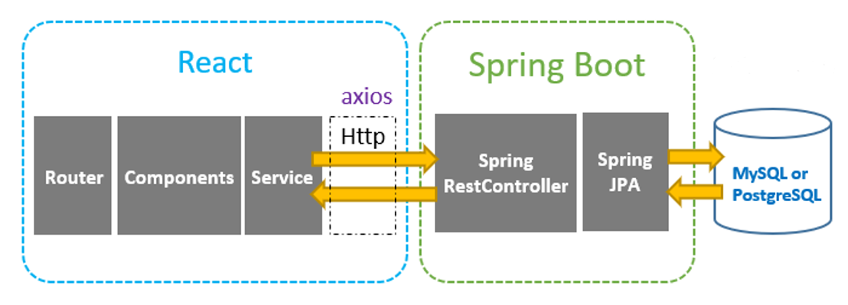
MyHealthy API Layout

Slide 2
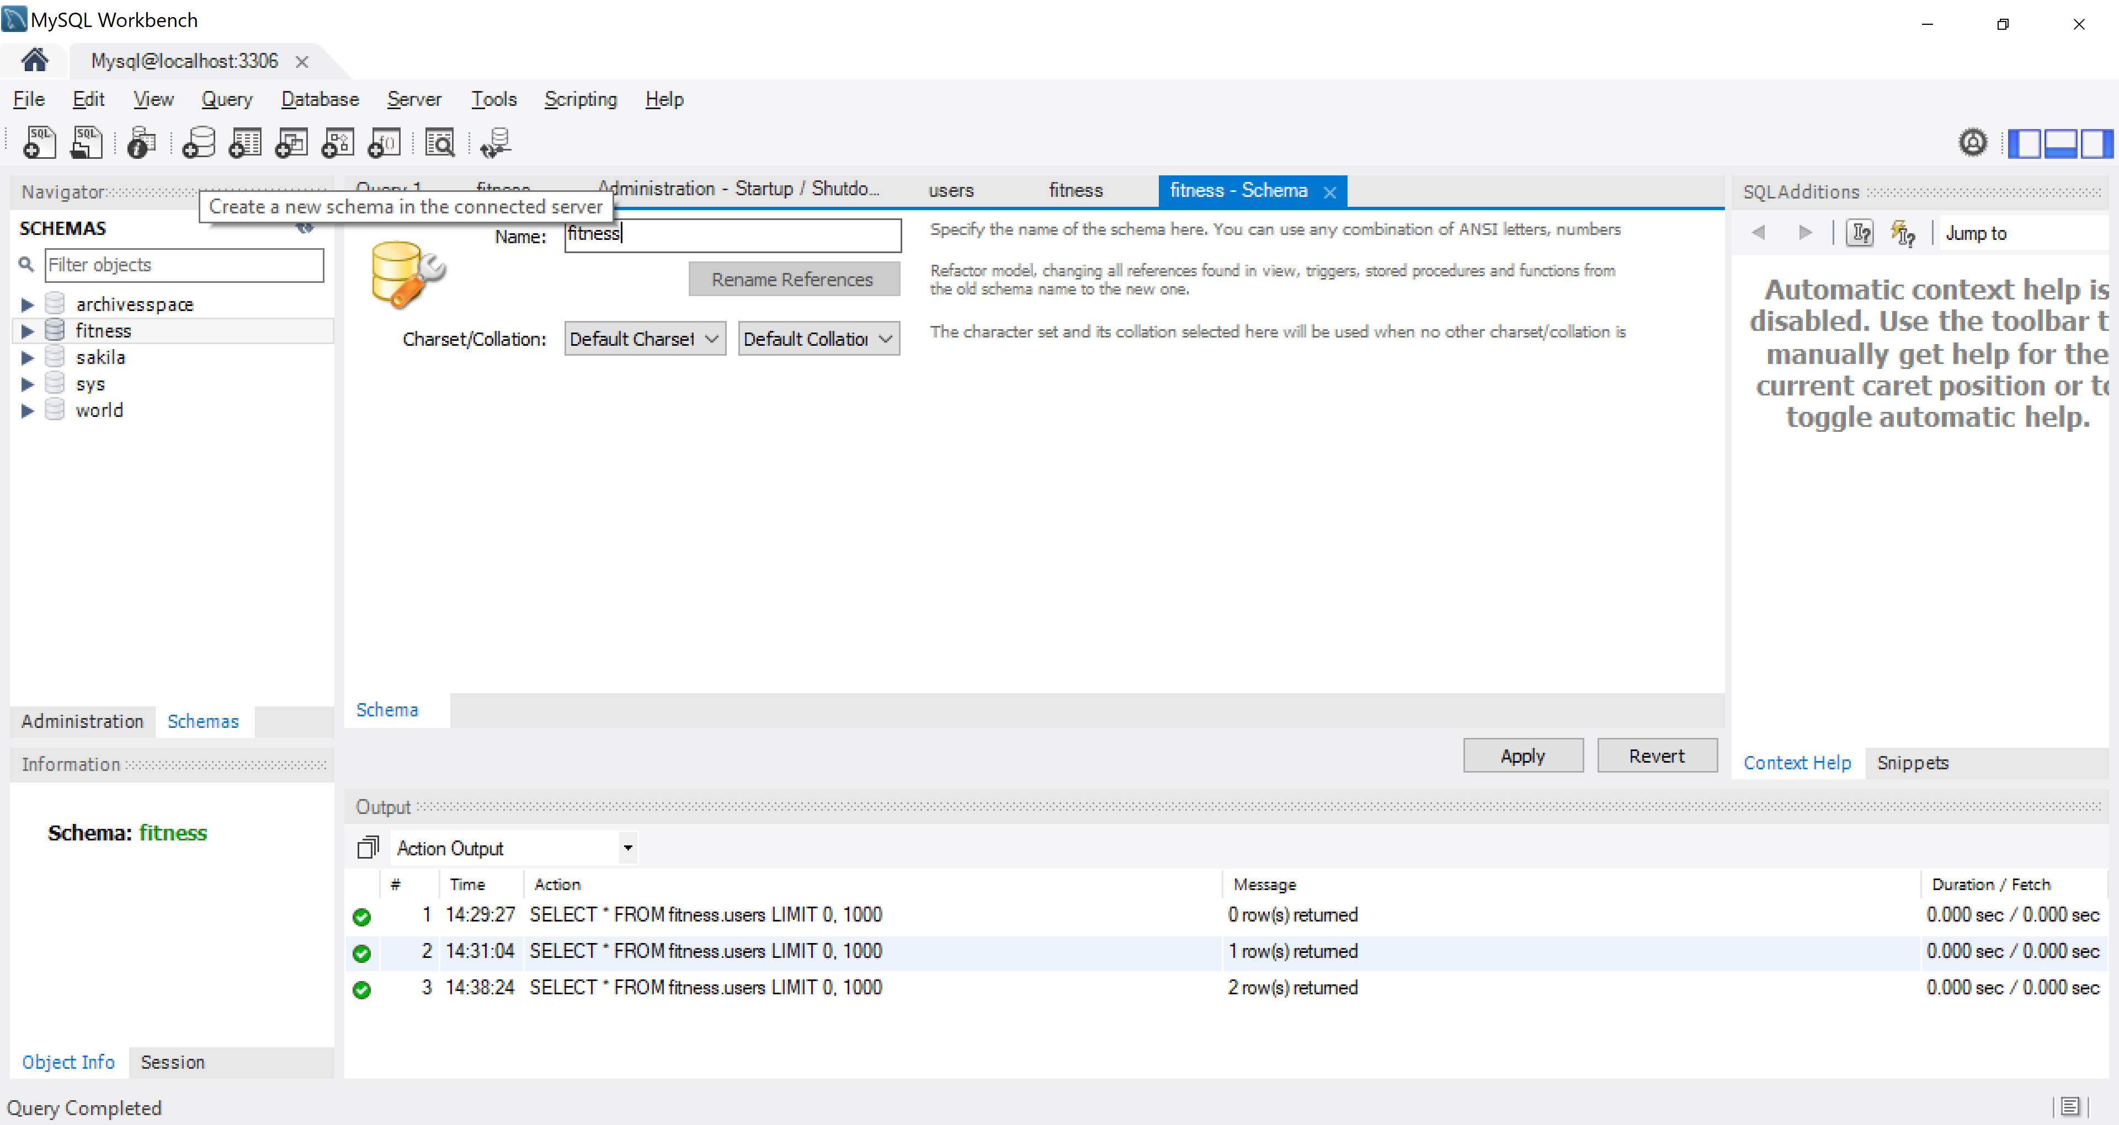
Create the “fitness” database

Slide 3
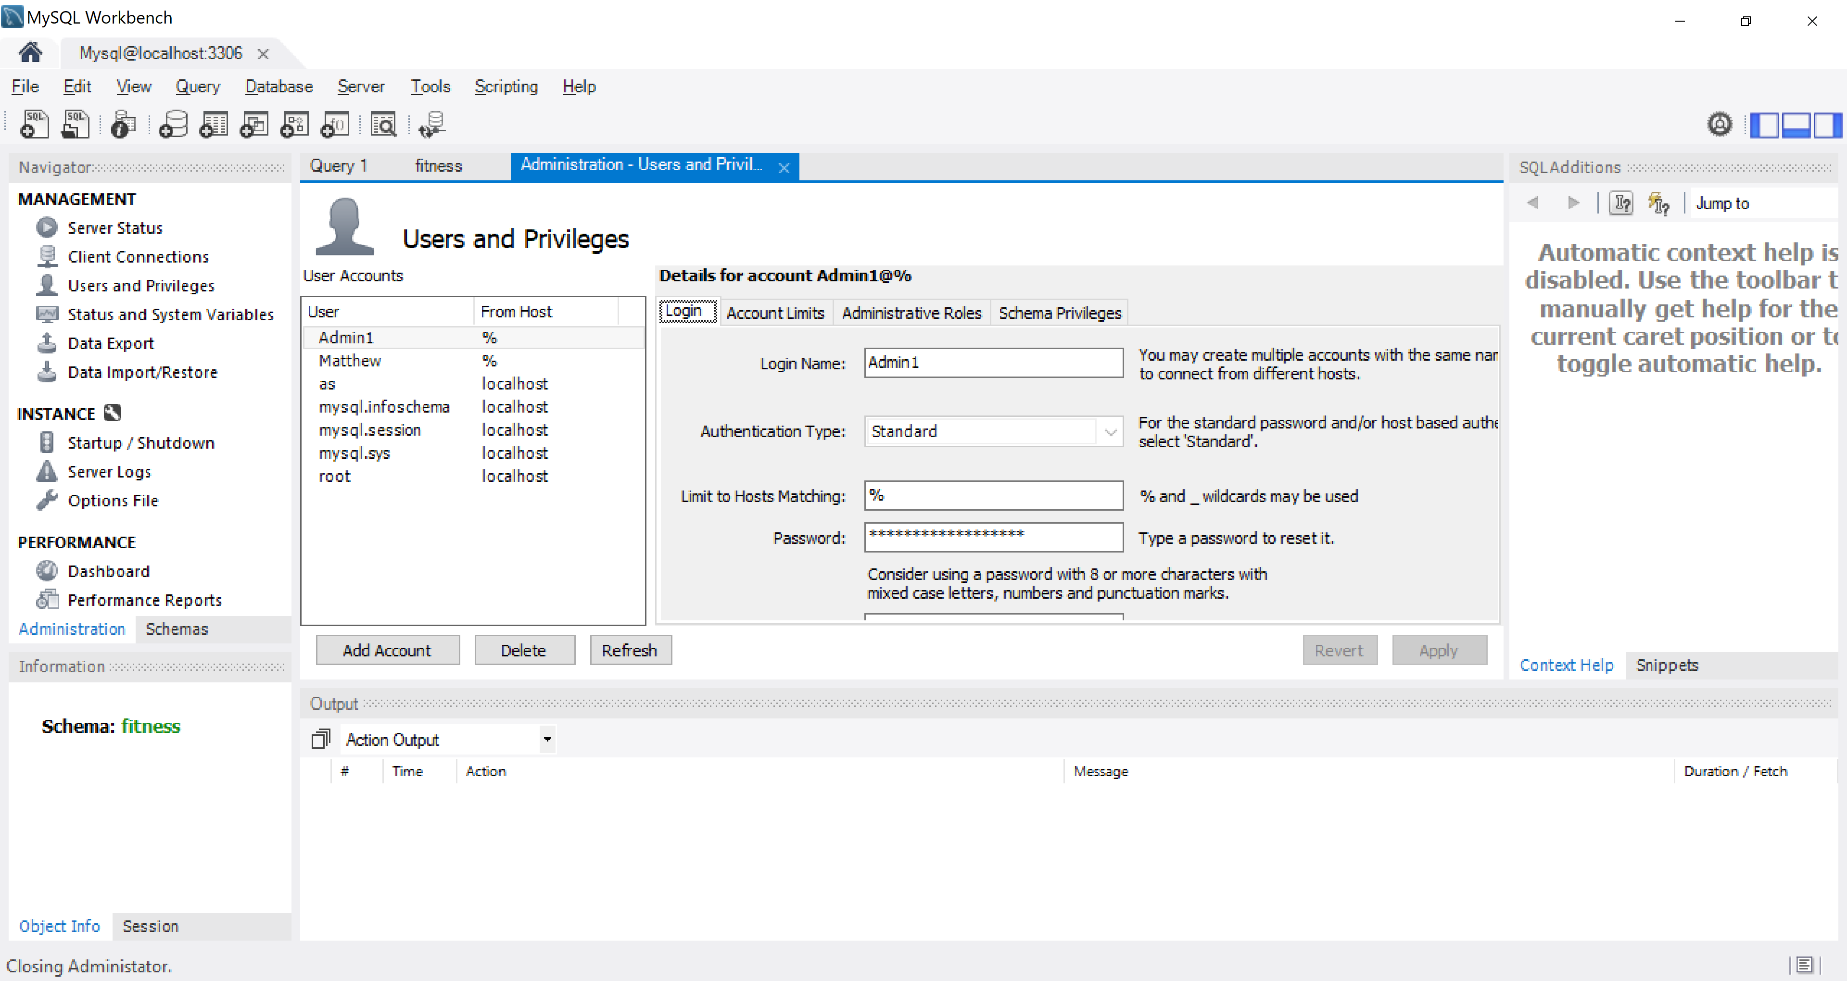
Create an account with username Admin1 and password Admin1PW!

Slide 4
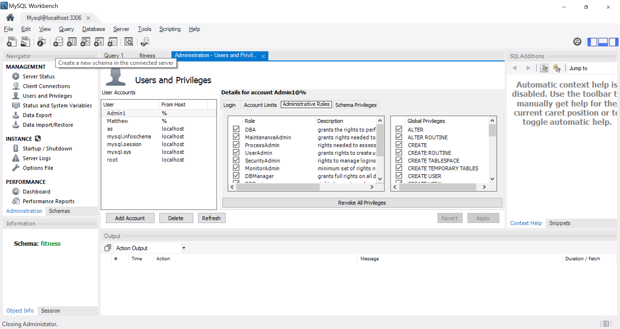
DBA admin rights to the Admin1 user account

Slide 5
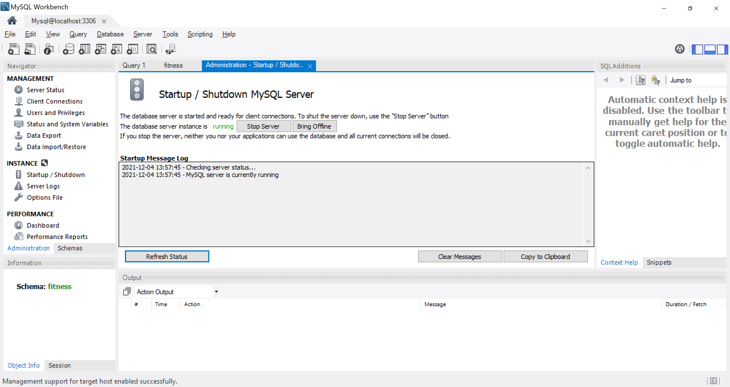
Make sure MySQL Server is running (use the Startup/Shutdown tab)

Slide 6
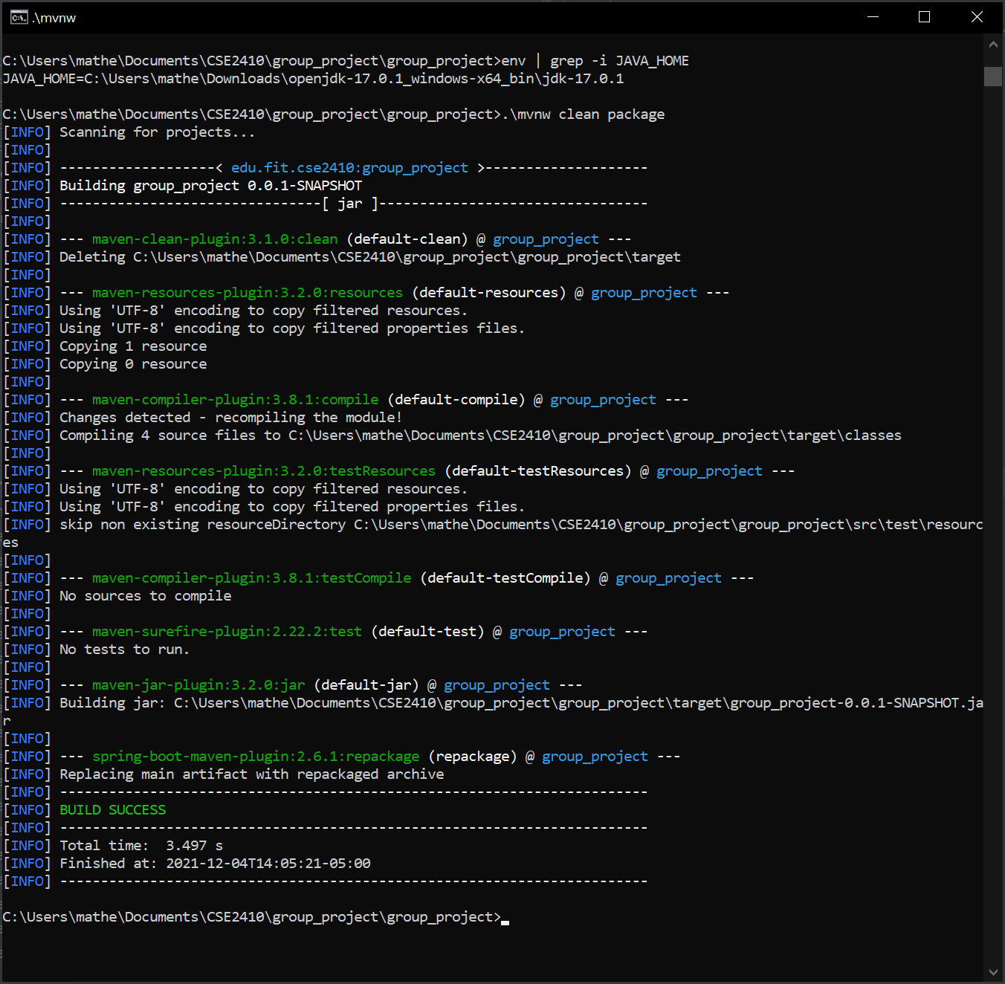
Build with ./mvnw clean package. Make sure JAVA_HOME environment variable is jdk(not jre)

Slide 7
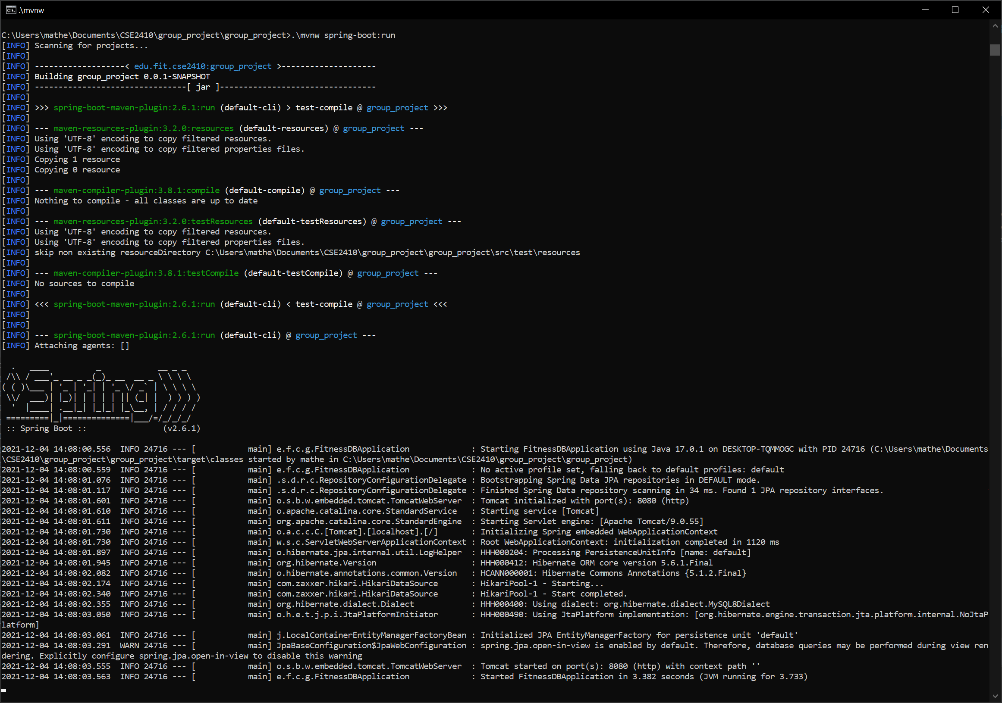
Run Spring service with .\mvnw spring-boot:run

Slide 8
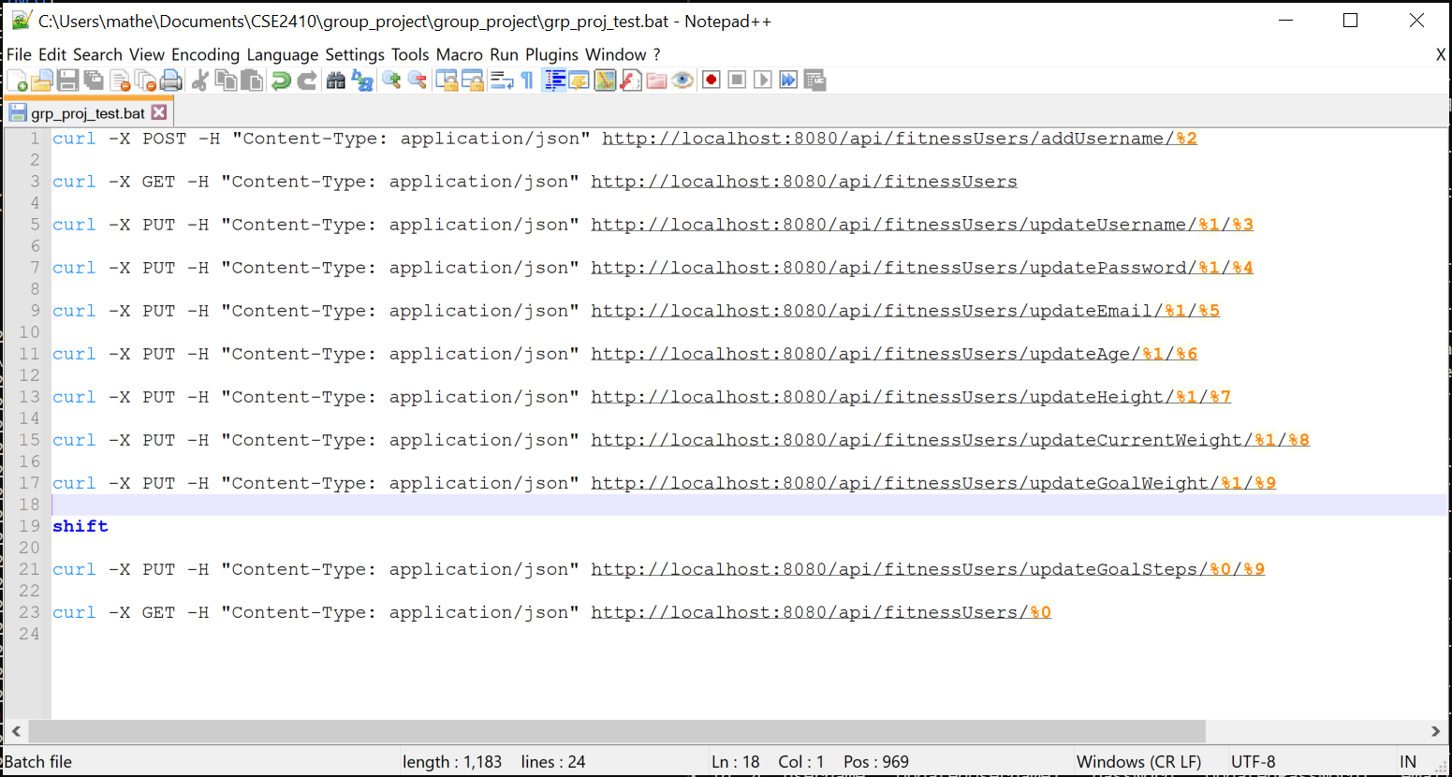
Curl script (grp_prj_test.bat) for testing

Slide 9
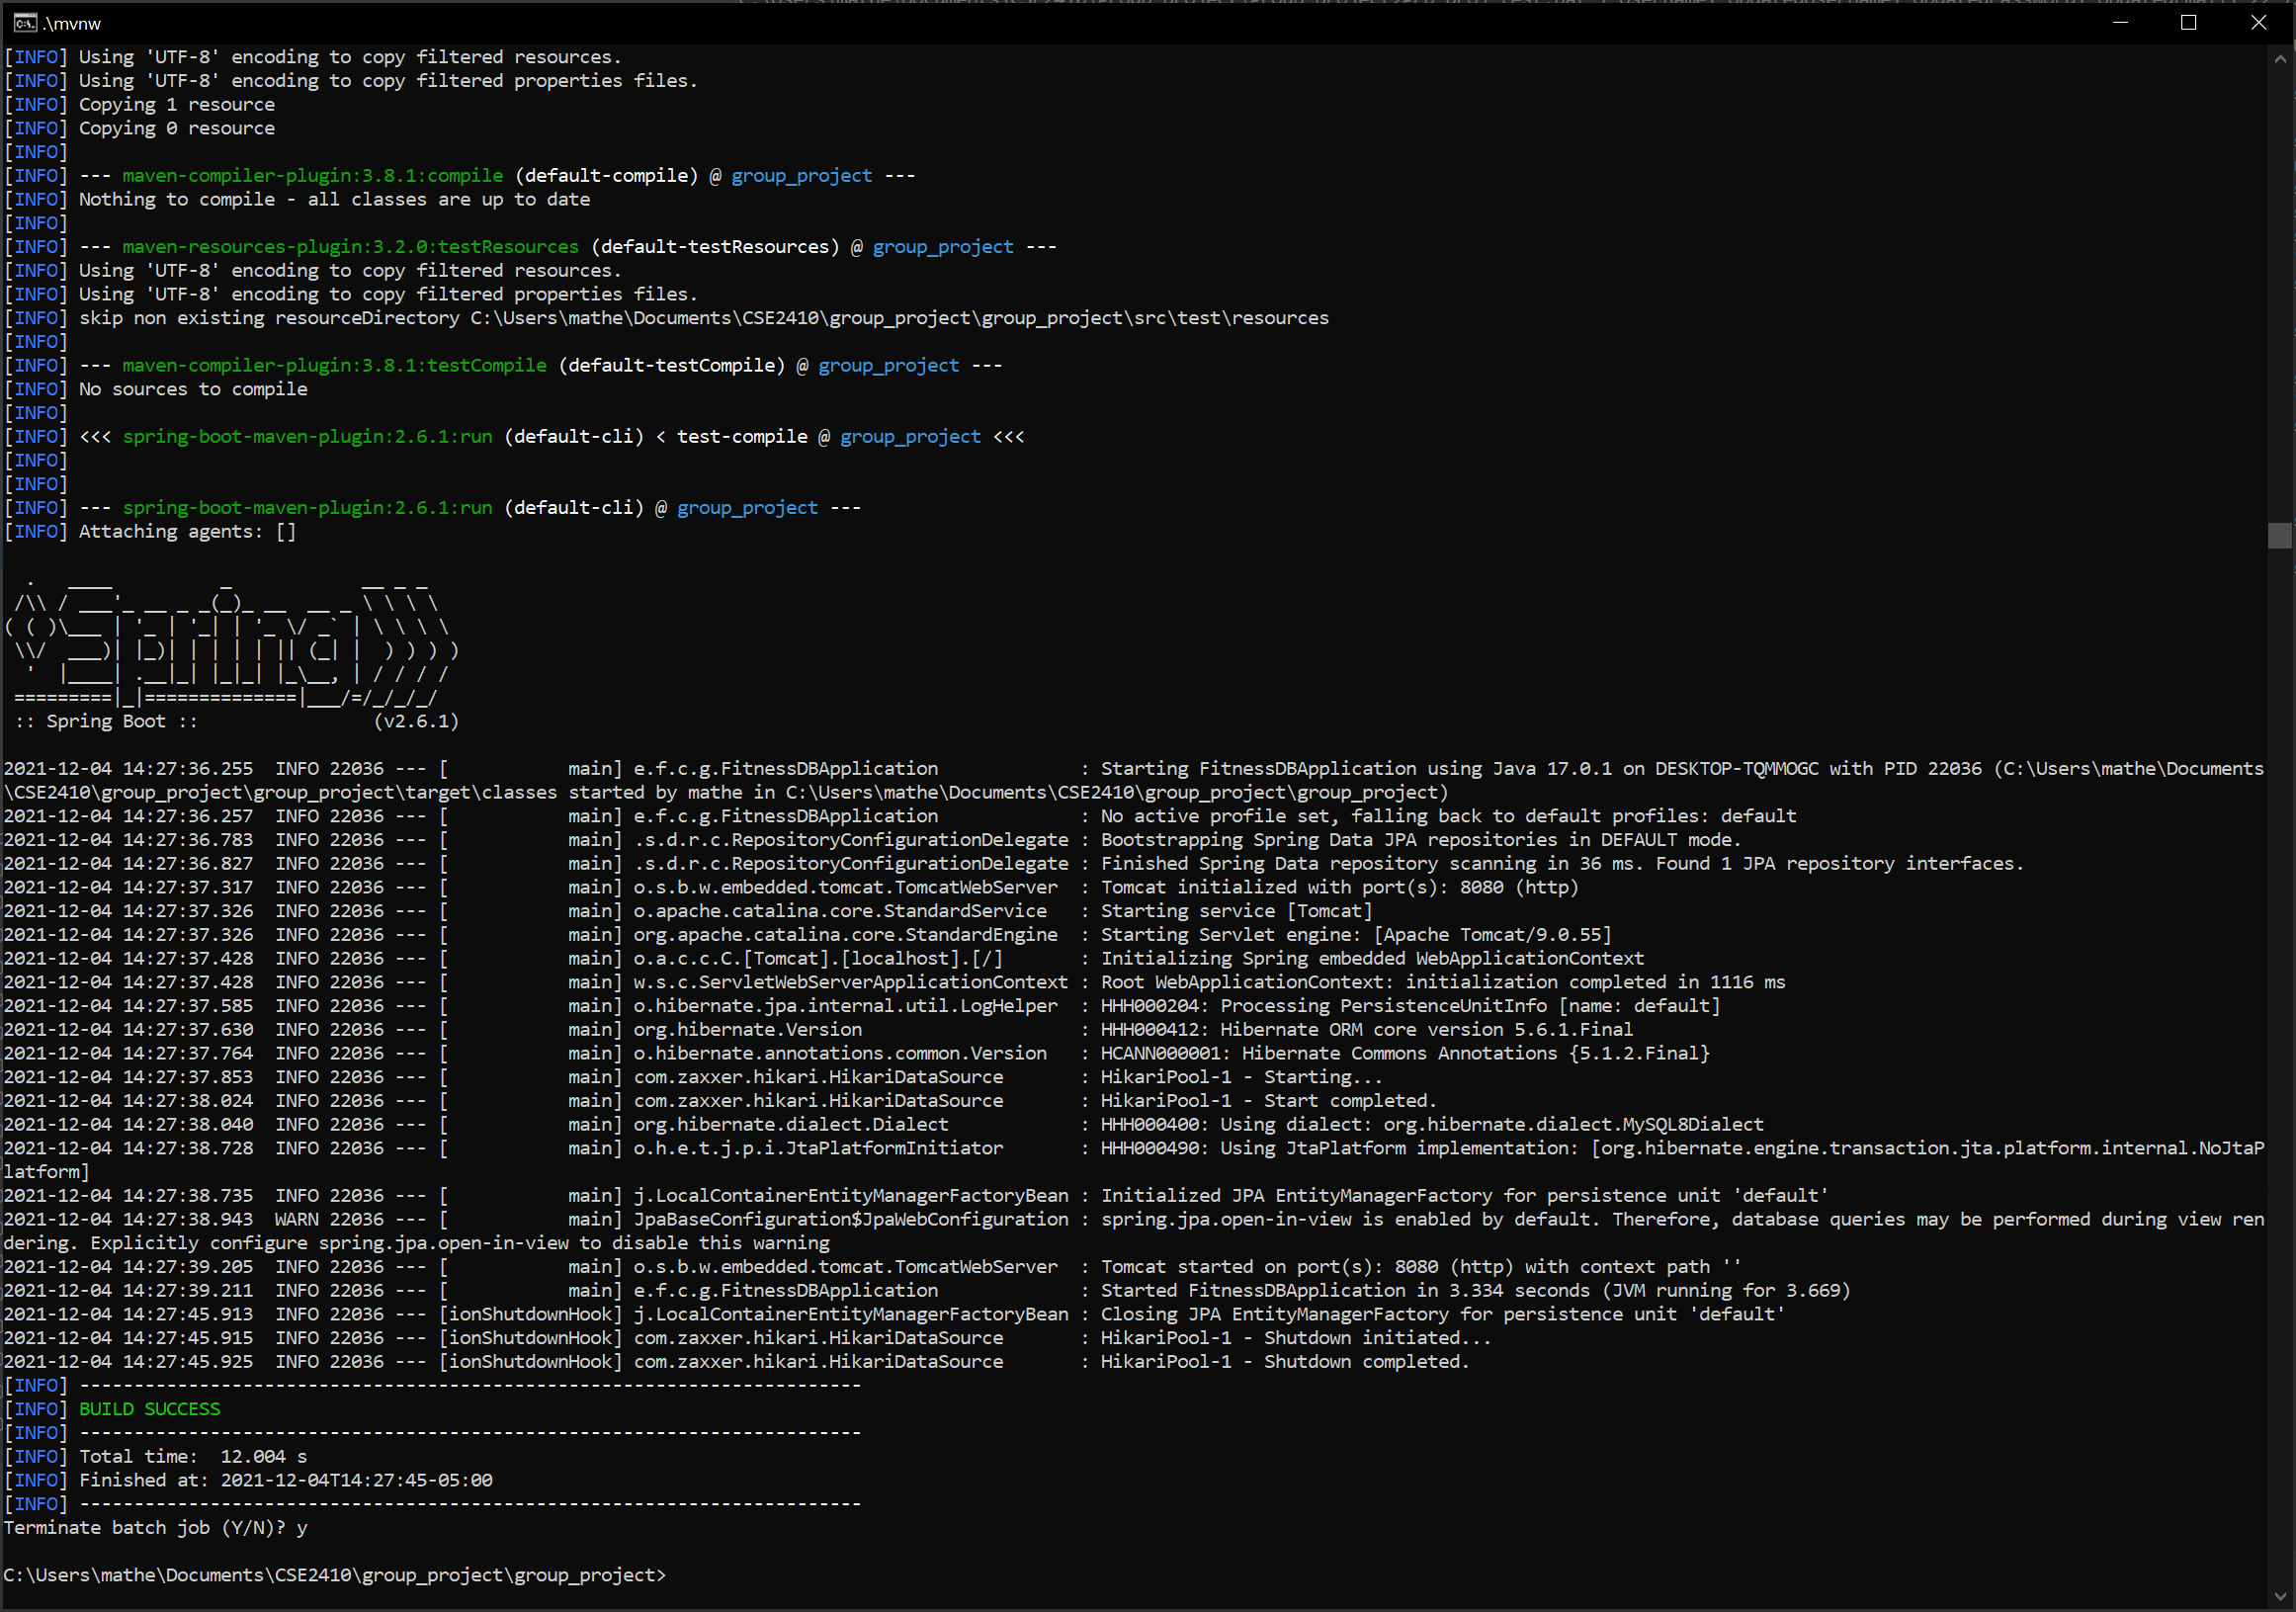
Stop Service with Control C when done

Slide 10
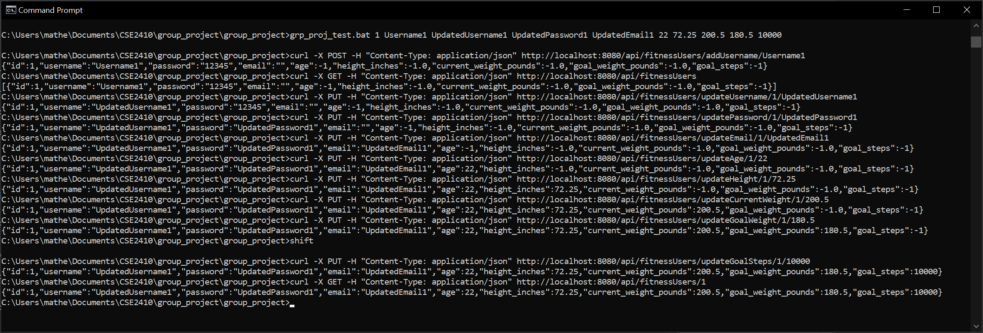
Curl script command for adding a user to the database

Slide 11
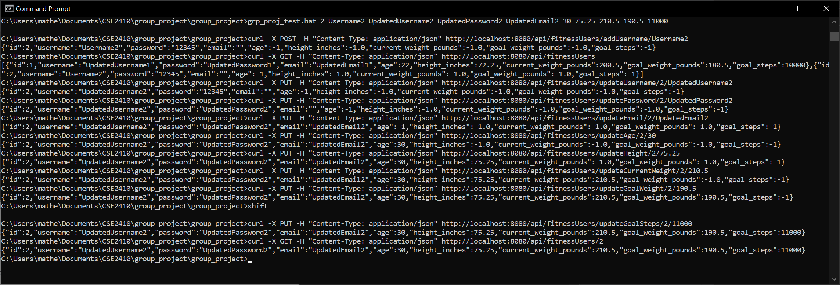
Curl script command to add a 2nd user to the database

Slide 12
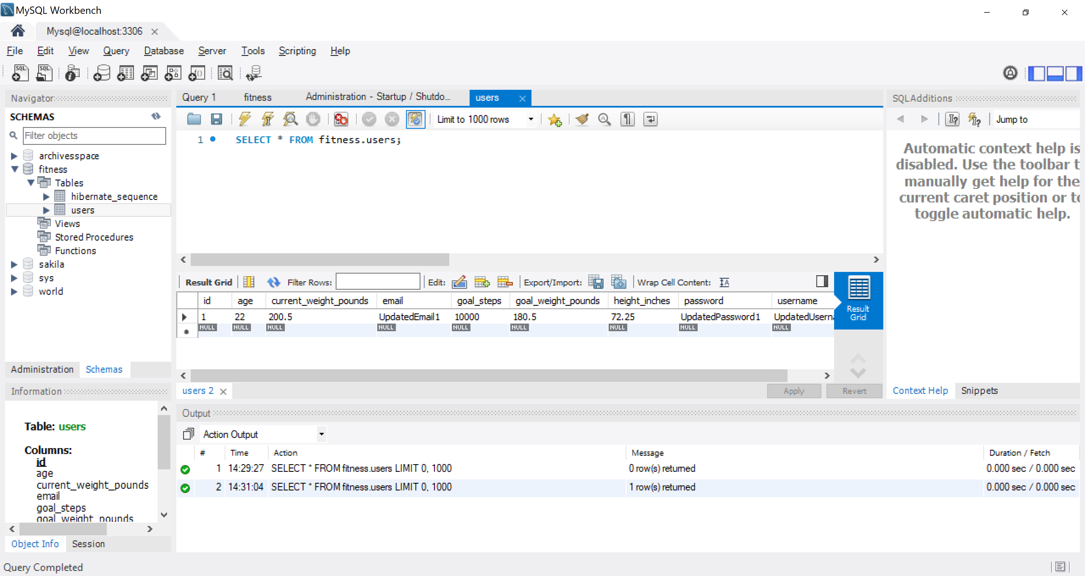
Database in MySQL with 1 user

Slide 13
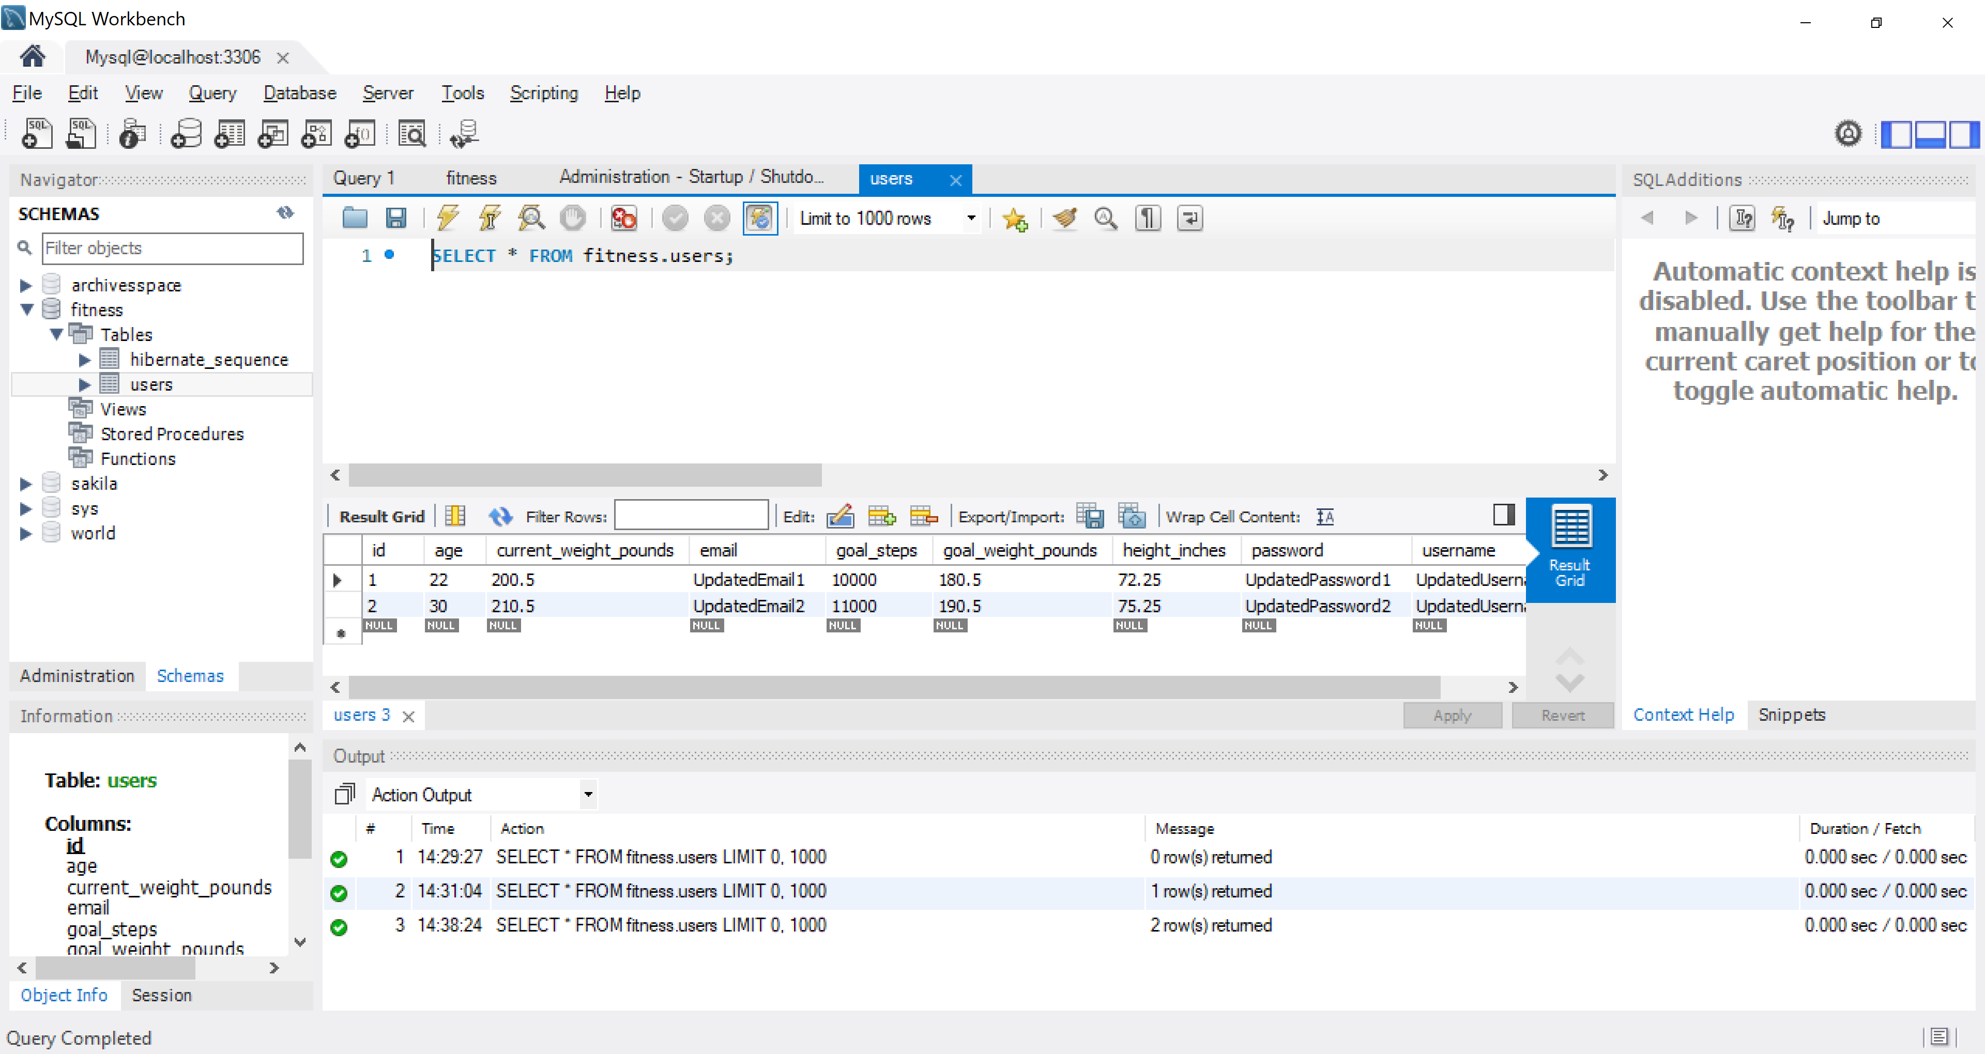
Database in MySQL with multiple users

Slide 14
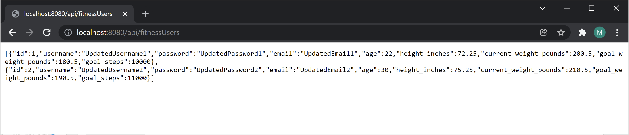
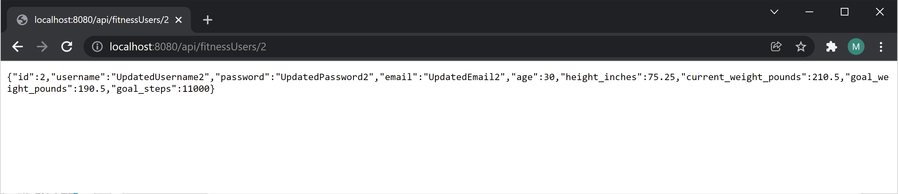
Localhost webservice with database in JSON

Slide 15
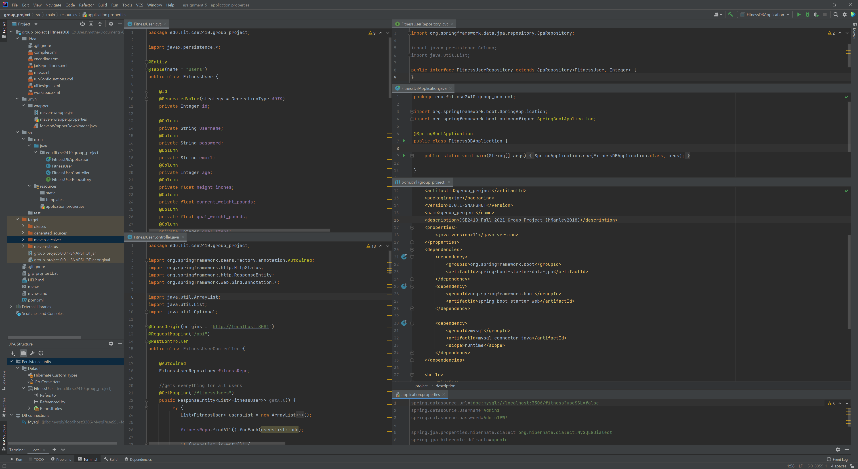
Back-end code on IntelliJ

